Slide 1
Statistics
The Hottest Career of the 21st Century

Slide 2
What is statistics?
It’s not what you think it is.

Slide 3
First, statistics offers tremendous
opportunity for graduates.
Most in-demand skill in 2014, according
to LinkedIn.
Among the fastest-growing jobs.
The McKinsey Global Institute predicts a shortage of up to 190,000 people with the data analysis skills to work with Big Data.

Slide 4
More than 40% of statistics
undergraduate degrees go to women.
Offers a wide variety of careers to choose from.
Ranked by Fortune as the top graduate degree based on salary, growth and job satisfaction.

Slide 5
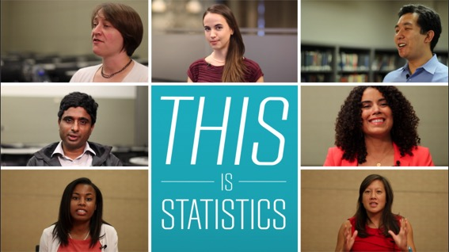
Second, it’s an exciting and interesting
field where your work really matters.

Slide 6

“The Fastest-Growing STEM Major in the U.S.”
Move over, computer science. Bachelor’s Degrees in
Statistics have soared 95% since 2010…the number
of U.S. colleges granting degrees in the field has already
gone up, from 74 in 2003 to 110 within 10 years,
and 20 more schools have recently added new programs.
Source: Fortune, February 10, 2015.

Slide 7
Statistics education also offers a strong
return on investment

Slide 8
So, what is statistics, and what do
statisticians do?
Statistics is the science of
learning from data.

Slide 9


    Statisticians help manage the earth’s natural resources
Fjallsjökull glacier in Iceland

Slide 10

    Statisticians reduce disease and improve medicines
Spiral strand of DNA

Slide 11

  Statisticians work for professional sports teams to make strategic draft picks
Jarvis Hayes, Darius Songalia, Mark Madsen and Rashad McCants. Image source: Keith Allison

Slide 12

  Statisticians improve voter targeting and assess the
  success of government policies and programs
President Barack Obama campaign rally in Urbandale, Iowa, 2012. Image source: White House (P090112PS-0411)

Slide 13

  Statisticians help protect human rights in
  developing countries
Yezidi children in an internally displaced person camp in Sharya, Iraq. Image source: Human Rights Data Analysis Group

Slide 14

    Statisticians advance computing through machine
    learning, speech recognition and artificial intelligence
Data center

Slide 15

  Statisticians are crucial to making industry more efficient
  and financial institutions stronger
Budweiser plant. Image source: Ryan Glenn

Slide 16

“Women Flocking to Statistics”
  As the demand explodes for workers in high-tech
  professions who can analyze the staggering amounts of raw digital data produced every year, women barely register.
  Except In One Field: Statistics.
Source: The Washington Post, “Women Flocking to Statistics, the Newly Hot,
High-Tech Field of Data Science,” December 2014.

Slide 17
Statistics education also is incredibly
useful in a wide array of majors
  Marketing
  Business and finance
  Medicine and healthcare
  Data Science
  Journalism
  Communications and public relations
  Government and public policy

Slide 18
So, what are you waiting for?
Start studying statistics today!
  Sign up for a course in statistics.
  Consider doing a minor in statistics.
  If you like everything you’ve heard today, consider pursuing a degree in statistics.
The possibilities are endless.

Slide 19
Learn more at ThisisStatistics.org

